Slide 1

Introduction to Cyber Security
Ritesh Dhanare
Assistant Professor
Information technology Department

Slide 2
Table of Contents
Security Policies
Types of security policies

Slide 3
Security Policies
A security policy is a statement that partitions the states of the system into a set of authorized, or secure, states and a set of unauthorized, or nonsecure, states.
A secure system is a system that starts in an authorized state and cannot enter an unauthorized state.
A breach of security occurs when a system enters an unauthorized state.

Slide 4
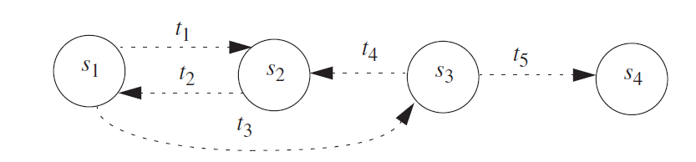
Security Policies

Slide 5
Let X be a set of entities and let I be some information. Then I has the property of confidentiality with respect to X if no member of X can obtain information about I.
Let X be a set of entities and let I be some information or a resource. Then I has the property of integrity with respect to X if all members of X trust I.
Let X be a set of entities and let I be a resource. Then I has the property of availability with respect to X if all members of X can access I.

Slide 6
A security mechanism is an entity or procedure that enforces some part of the security policy.
A security model is a model that represents a particular policy or set of policies.

Slide 7
Types of Security Policies
A military security policy (also called a governmental security policy) is a security policy developed primarily to provide confidentiality.
A commercial security policy is a security policy developed primarily to provide integrity.

Slide 8
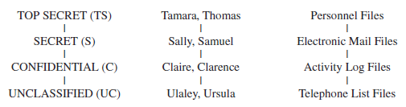
Confidentiality Policy
The Bell-LaPadula Model

Slide 9
Let L(S) = ls be the security clearance of subject S, and let L(O) = lo be the security classification of object O. For all security classifications li, i = 0, ..., k – 1, li < li+1.
Simple Security Condition, Preliminary Version: S can read O if and only if lo ≤ ls and S has discretionary read access to O.
*-Property (Star Property), Preliminary Version: S can write O if and only if ls ≤ lo and S has discretionary write access to O.

Slide 10
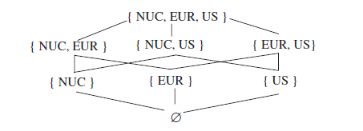

Slide 11
The security level (L, C) dominates the security level (L´, C´) if and only if L´ ≤ L and C´ ⊆ C.

Slide 12
George is cleared into security level (SECRET, { NUC, EUR} ), DocA is classified as ( CONFIDENTIAL, { NUC } ), DocB is classified as ( SECRET, { EUR, US}), and DocC is classified as (SECRET, { EUR }). Then:
George dom DocA as CONFIDENTIAL ≤ SECRET and { NUC } ⊆ { NUC, EUR }
George ￢ dom DocB as { EUR, US } ⊄ { NUC, EUR }
George dom DocC as SECRET ≤ SECRET and { EUR } ⊆ { NUC, EUR }

